Slide 1

MAGIC CARPET

Slide 2
Prepared by:
Mrutyunjay Rout
1905106015
3rd Semester, MCA
mrutyunjayrout111@gmail.com
Under the Guidance of:
Mr. Ratnakar Das
rkdas.puri@gmail.com
College of Engineering and Technology
Ghatikia, Bhubaneswar, 751019

Slide 3
Content
Introduction
Objective
New Features
Functionalities
System Configuration
Diagrams
Output Screen

Slide 4
01
INTRODUCTION
In order to facilitate users to rent a vehicle when required, we designed a vehicle rental system. It is more feasible than owning a vehicle and maintaining it.
Magic Carpet rental system serves people who don't own a vehicle or require extra conveyance for travels etc, who are out of town or tourists or owners of damaged vehicle who are awaiting repair or insurance​ ​compensation.

Slide 5
02
OBJECTIVE
The objective of this project is to automate vehicle rental and reservation so that customers do not need to call or visit and spend unnecessary time in order to reserve a vehicle.
They can go online browse through wide range of vehicles and reserve any kind of vehicle they want and that is available; thus reducing paper work and time.
It will maintain the records conveniently. And the service provider can track bookings from anywhere.
That will simplify staff and vehicle management for a car rental company

Slide 6
03
UNIQUENESS OF PROPOSED SYSTEM
In existing system the service provider is also the vehicle owner. Thus limiting the service reach to certain big cities. But here we allow other motor owners to be associate of us. Thus extending our reach to wide range of cities.
We also provide on road garage facility & replacement service aiming complete customer satisfaction

Slide 7
04
FUNCTIONALITIES:
Log in & sign up securely
easily reserve a car from remote location
Pickup & return at your desired location
Browse vehicle of your choice easily
Admin can add, remove, insert, update vehicle database
Customer can use unique order ID for on-road assistance

Slide 8
05
SOFTWARE USED:
HARDWARE USED
Frontend:
Intel i3 8th generation processor
4 GB RAM
1TB HDD
Windows 10, 64-bit
html
css
javascript
Backend:
php
mySQL
IDE:
Visual Studio Code
Tool:
Xampp

Slide 9

06
USE CASE DIAGRAM
Log in / Sign up
Give pickup & return info
Add / Remove user
View Catalogue
Maintain Vehicle Info
Make Booking
Manage Booking
Admin
User
Make payment
Check Status
Get Vehicle
Input Location for Sending & Receiving car
Return Vehicle
(penalty if applicable)
Log out

Slide 10
07
Data Flow Diagram
User
If registered
YES
Login
Give pickup and return details
Browse available vehicles
Choose your vehicle
NO
Sign Up
Payment
Get unique order ID
Give penalty
YES
If any assistance required
Logout
Damage
Return vehicle
NO
NO
YES
On the way garage
Contact us

Slide 11
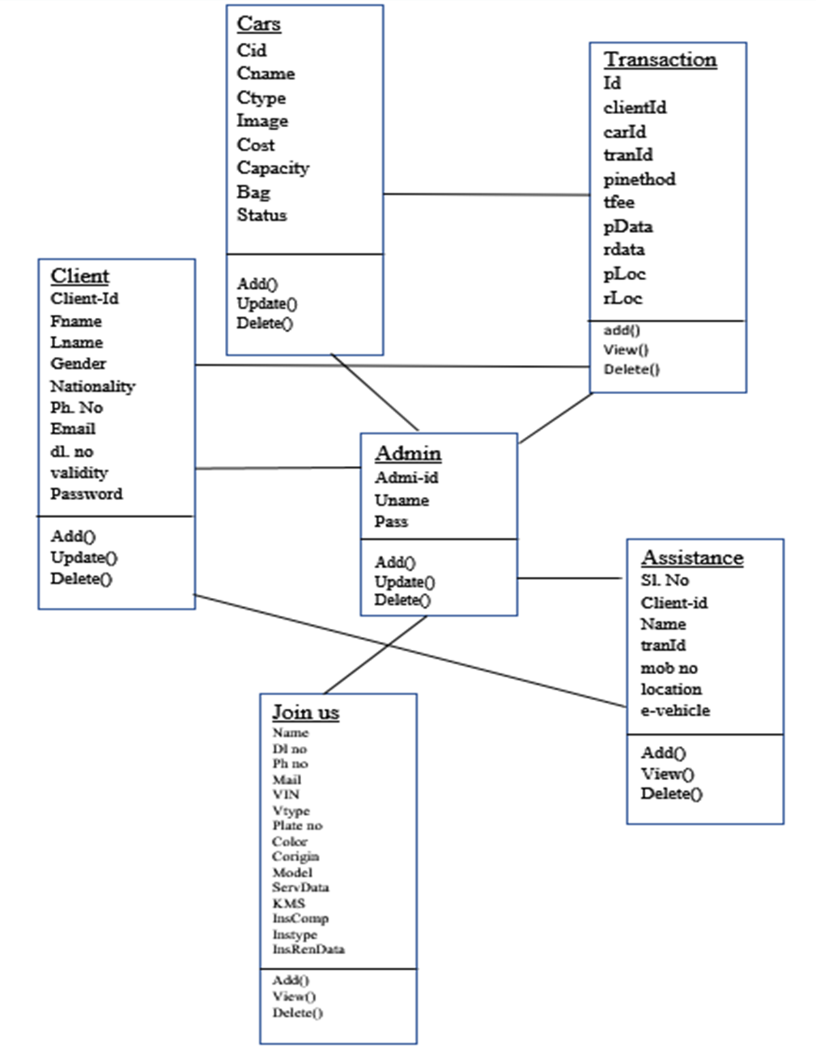
08
CLASS DIAGRAM

Slide 12
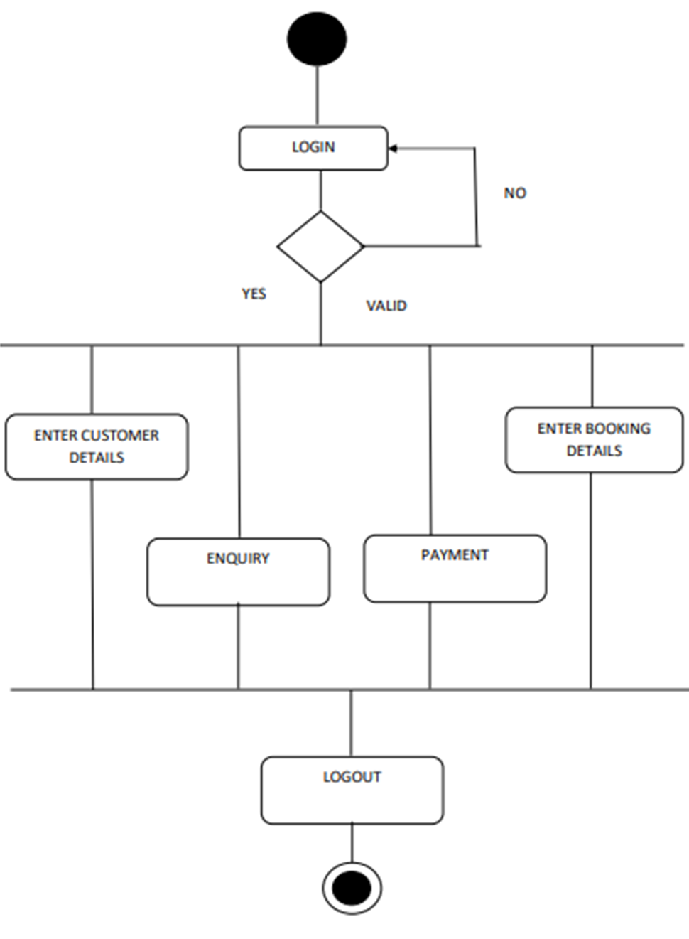
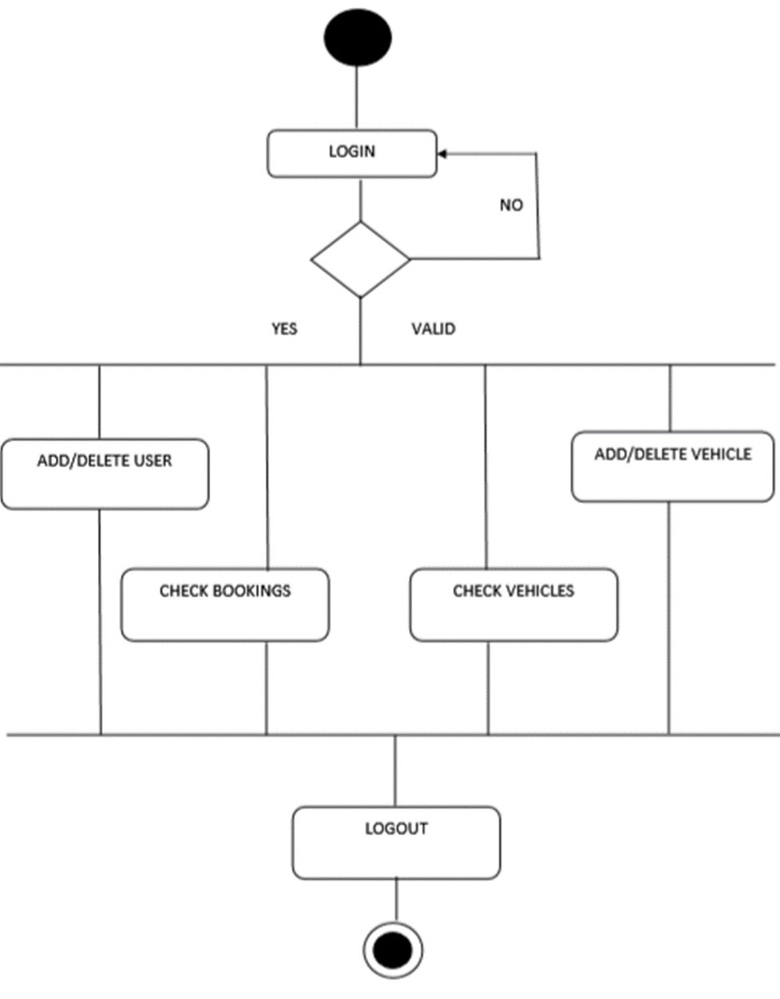
09
ACTIVITY DIAGRAM
USER
ADMIN

Slide 13
08
OUTPUT SCREENS

Slide 14
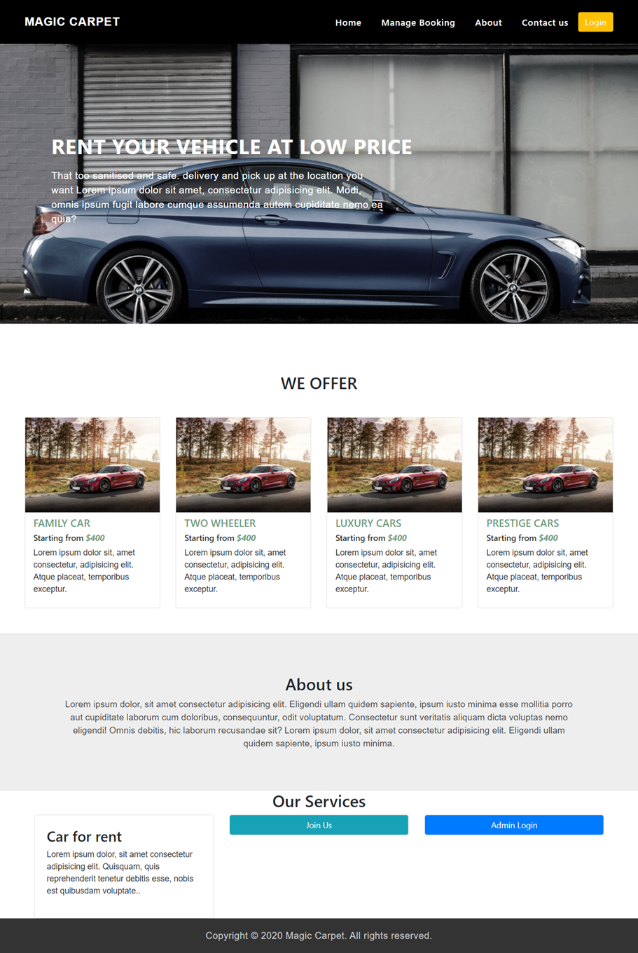
HOME PAGE

Slide 15
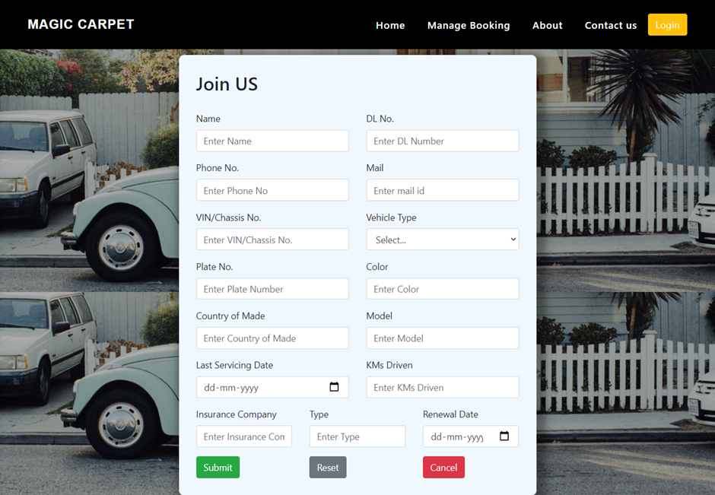
JOIN US

Slide 16
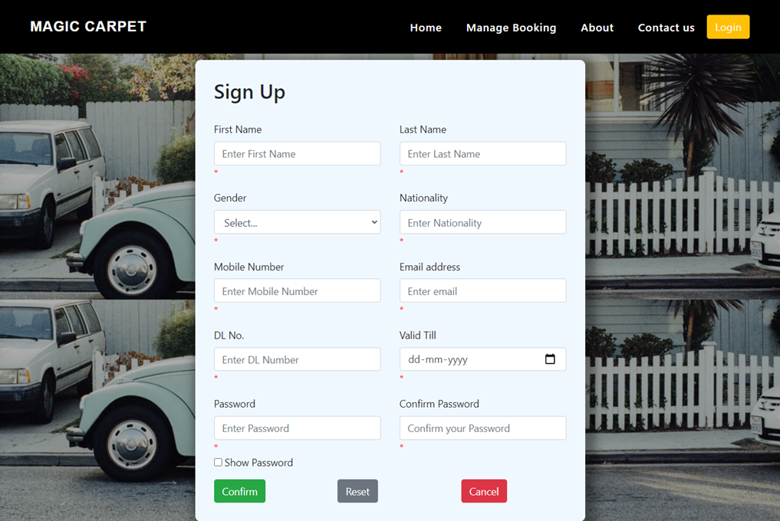
SIGN UP

Slide 17
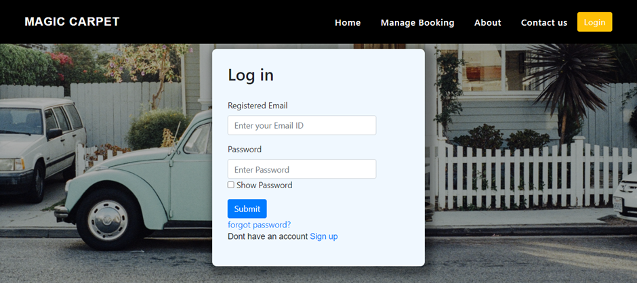
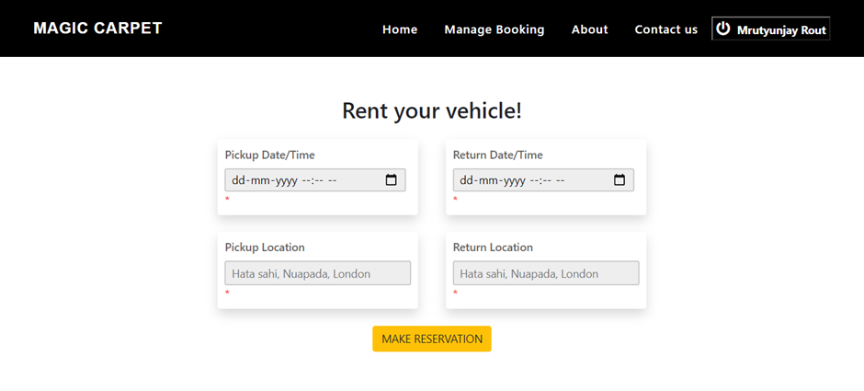
LOG IN
MANAGE BOOKING

Slide 18
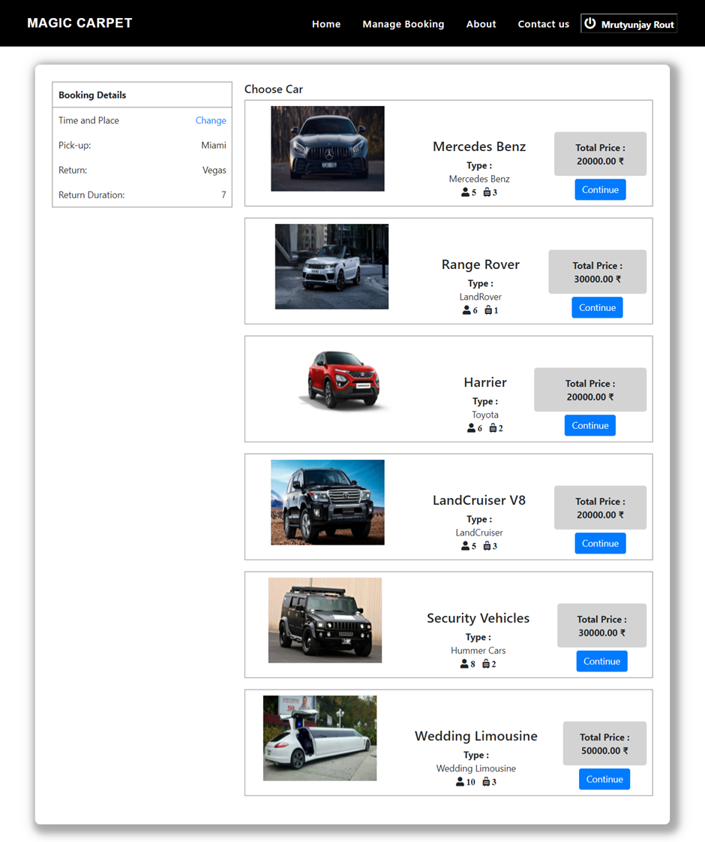
CHOOSE CAR PAGE

Slide 19
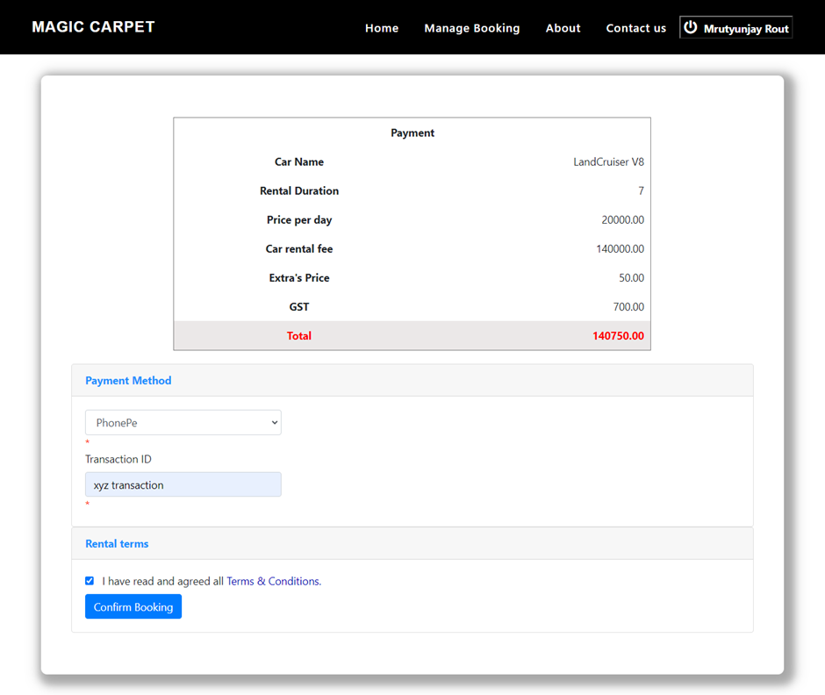
PAYMENT PAGE

Slide 20
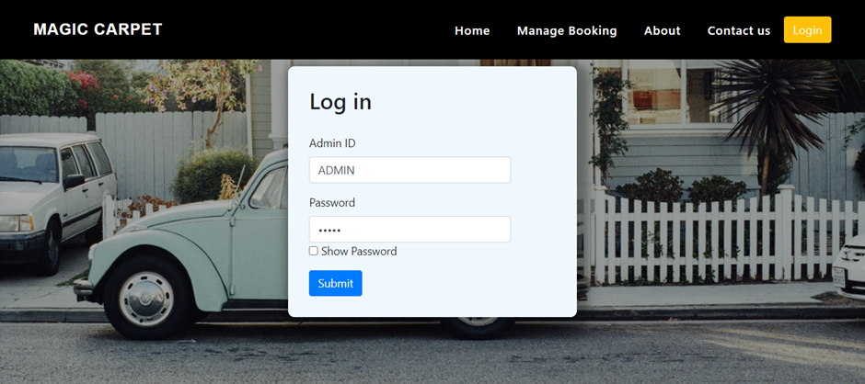
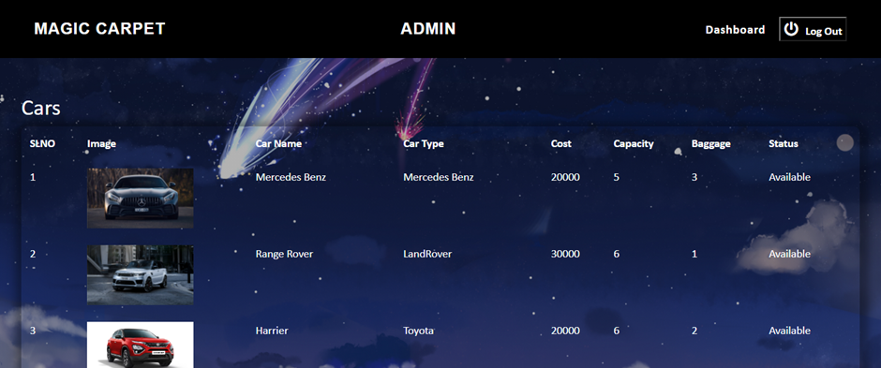
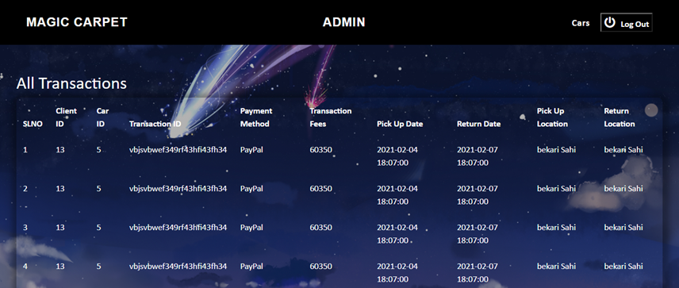
ADMIN LOG IN & FUNCTIONALITIES

Slide 21
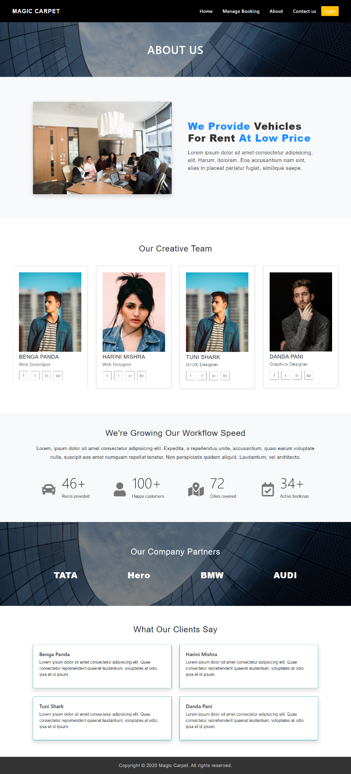
ABOUT PAGE

Slide 22
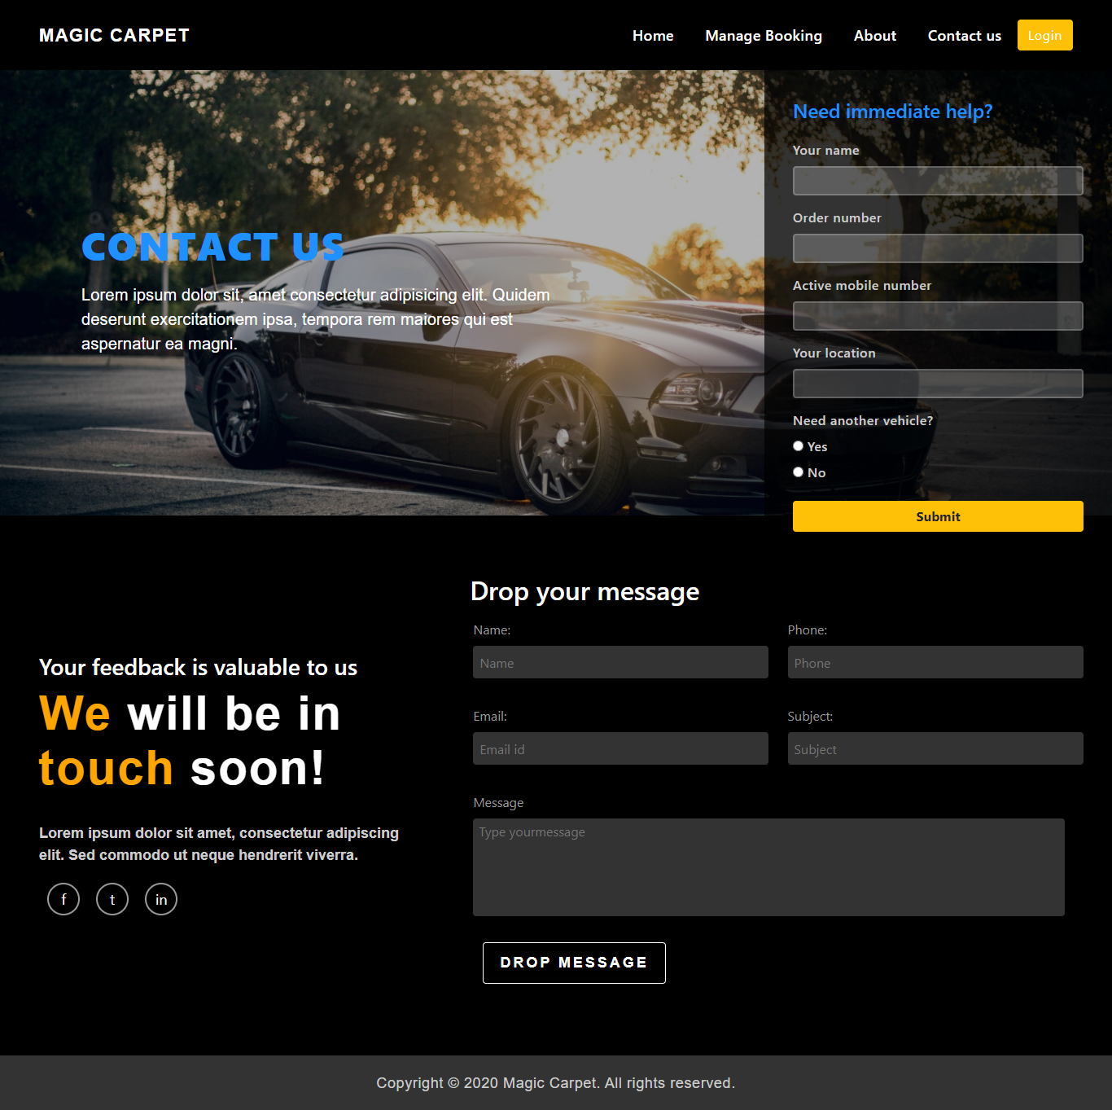
CONTACT PAGE

Slide 23


